Slide 1


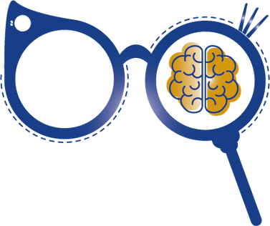


Mind’s Eye

Slide 2

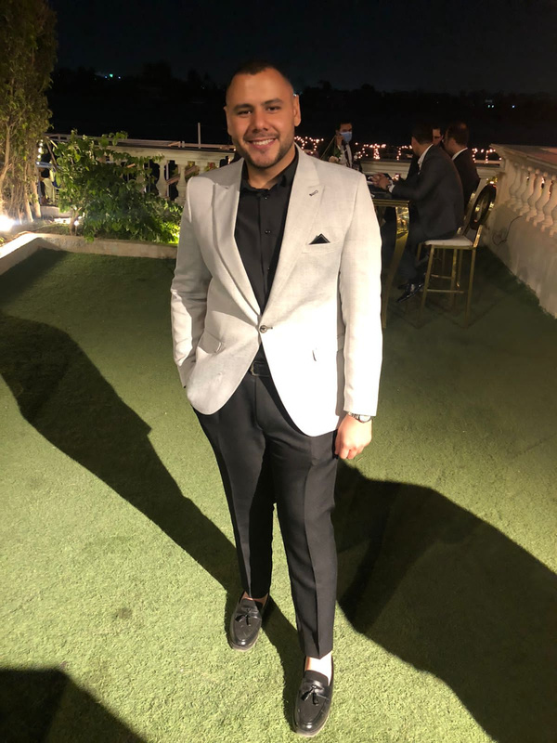
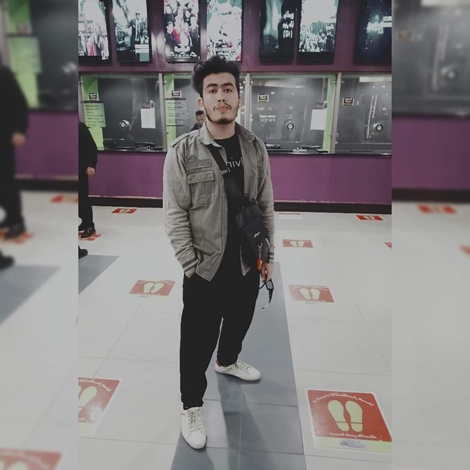

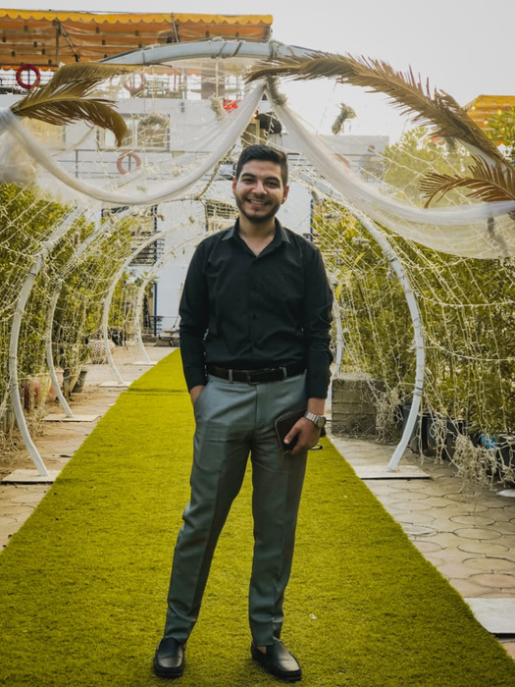
Meet Our
Team
Mohamed Nader
Yahya Adam
Omar Amgad
Aya Qortam
Mohamed Hesham

Slide 3



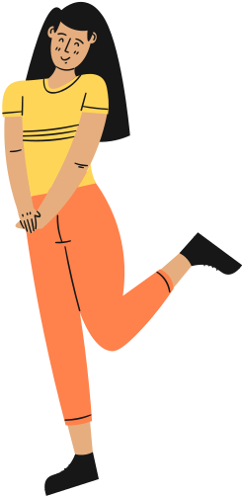
1
Introduction
2
Project Idea
AGENDA
3
Solution Approach
Are you ready?
4
Approach’s Features
5
Clouds services
6
Hardware Approach
7
Implementation
8
Tools
9
How To Use
10
Demo Video
11
Future Work
12
conclusion

Slide 4



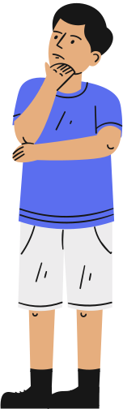

Introduction
Our Objective ?
And Why ?

Slide 5




OBJECTIVE
We've noticed that Egypt is giving too much care regarding disabilities lately. That's why we thought about this idea.
So, we decided to help the blind people and Alzheimer's people with our product.

Slide 6

HOW WOULD YOU FEEL IF YOU WOKE UP ONE DAY AND FOUND EVERYTHING WAS BLACK OR UNCLEAR?

Slide 7
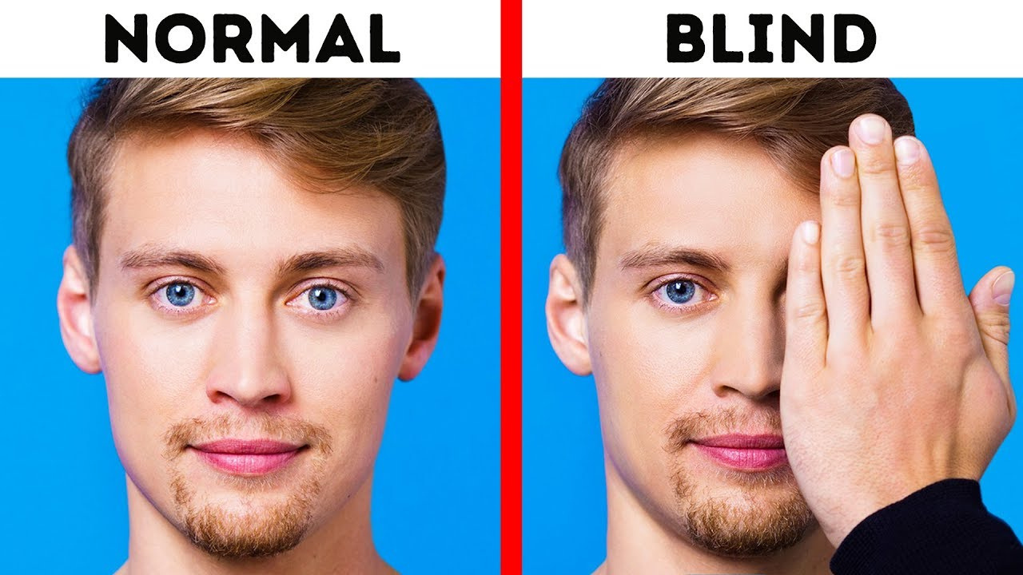



1- Try hiding your eye with one hand for 10 seconds
2- Remove your hand and hide the other eye
What do you see?
This is the feeling …
That is how to feel to be visually impaired
Try this, and tell us what would you feel?

Slide 8
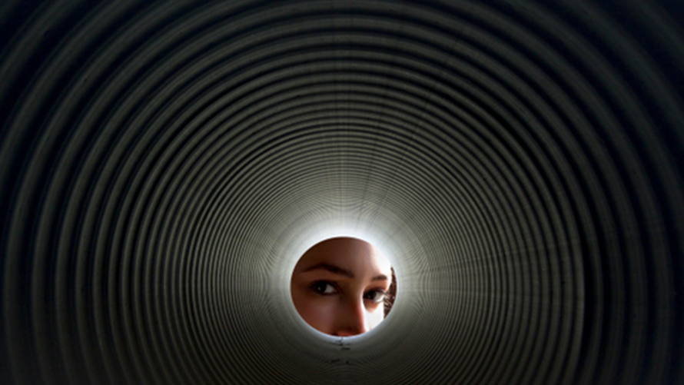
Imagine looking through a circle

Slide 9

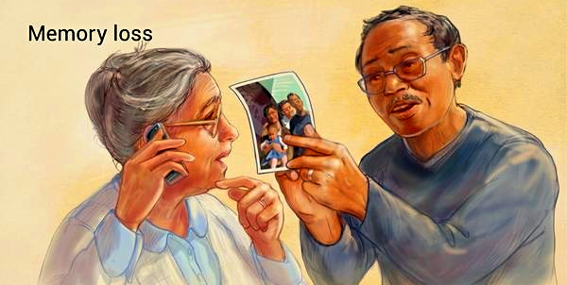

ALZHEIMER’S OVERVIEW
Alzheimer’s is a degenerative brain disease that is caused by complex brain changes following cell damage.
It leads to dementia symptoms that gradually worsen over time.
The most common early symptom of Alzheimer’s is having a problem with remembering new information because the disease typically impacts the part of the brain associated with learning first.

Slide 10
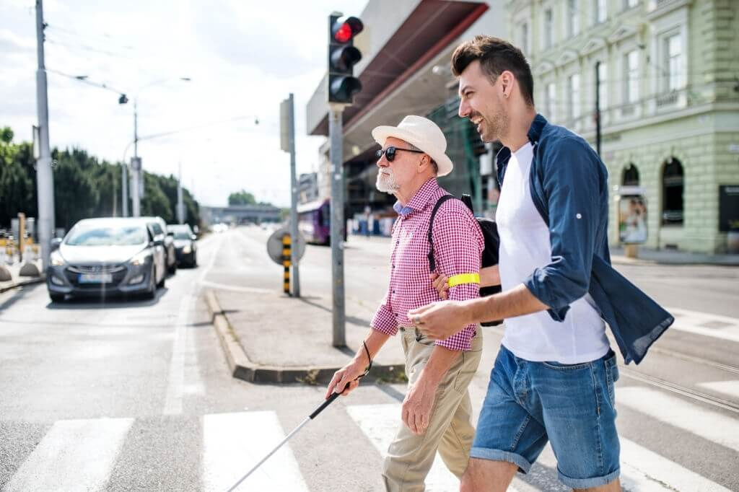
Problem
Statment
According to World Health Organization, around 285 million people
live with visual impairments worldwide, of which 45 million are blind.
If we are going to talk about visually impaired people in Egypt,
according to the World Health Organization (WHO), about 2.2 million
people with visual impairment in Egypt 900,000 of which are totally
blind.

Slide 11

Problem
Statment
And it is estimated that there are approximately 44 million people worldwide living with Alzheimer’s disease which is expected to increase to 135 million by 2050. In Egypt, an estimated 4 million people of all ages have Alzheimer’s disease.

Slide 12



we seek for making life better for those people with disability as much possible as we can by using the available technologies.

Slide 13
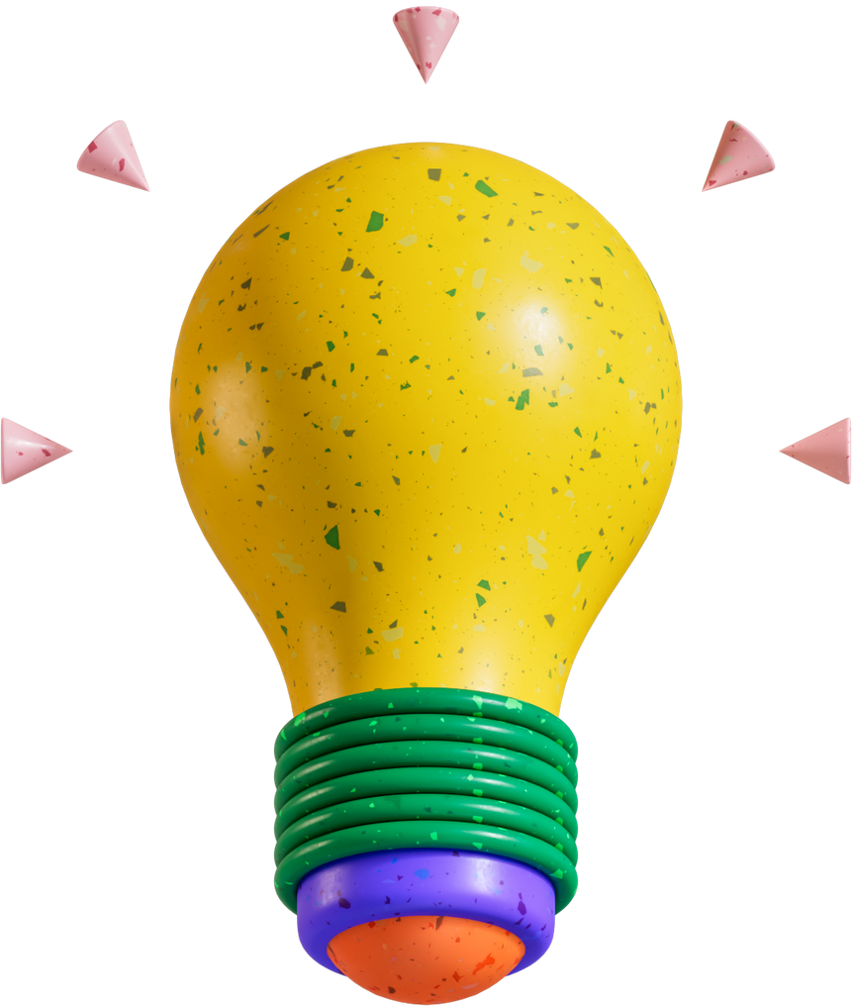

Solution
Approach

Slide 14


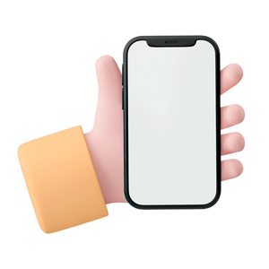

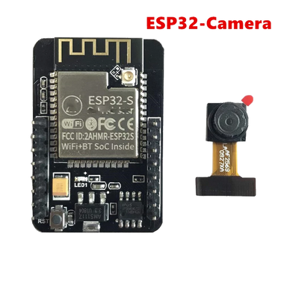


Solution Approach
We created a product that covers:
The daily needs of the people who are visually impaired
Alzheimer's people by reminding them of the name of the people around them Problem statement
Product components:
Android Application
Glasses
Esp32 Camera
The app connected over the bluetooth to a camera attached to glasses that the person will be wearing to help him capture the photo
Application has two modes:
visually impaired mode
Alzhaimer mode

Slide 15


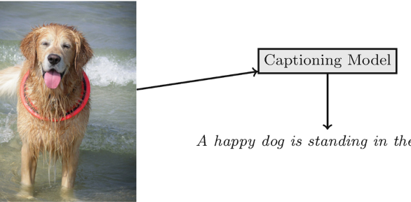
Visually Impaired
Our Application's
FEATURES
Labels detection
To help in detecting landmarks
Image captioning
To help in describing the scenes in the pictures

Slide 16
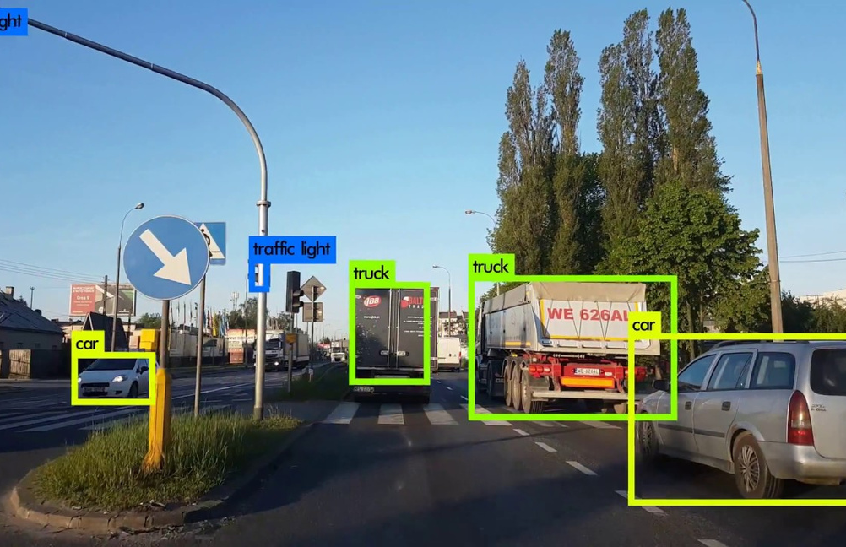
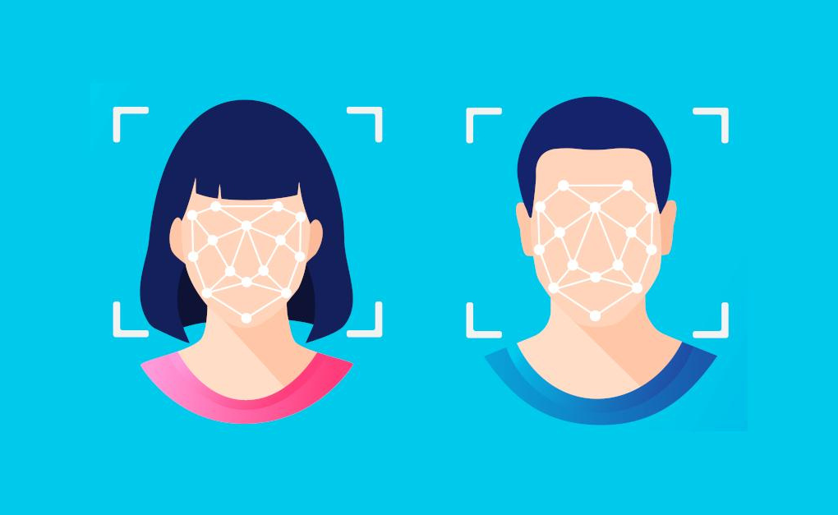
Visually Impaired
Our Application's
FEATURES
Object Detection
To help in analyzing and recognizing all the objects in the photo
Face detection
To help in detecting the persons in the photos and thierGender, emotion, expected age

Slide 17
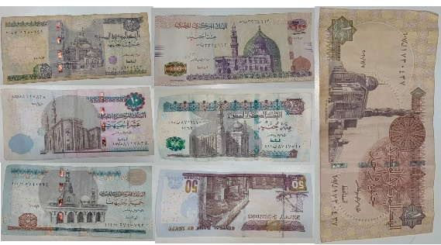

Visually Impaired
Our Application's
FEATURES
Currency Recognition
Text Reader
To classify the category of money do you have
To read the text printed anywhere for a banner or from a receipt or even printed books

Slide 18
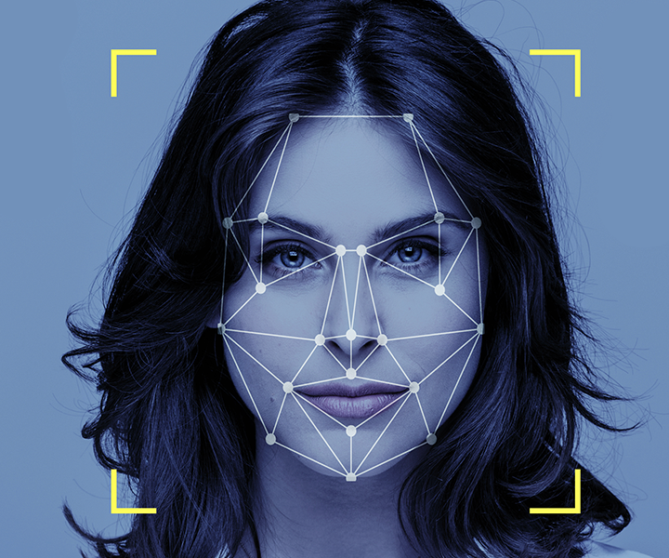
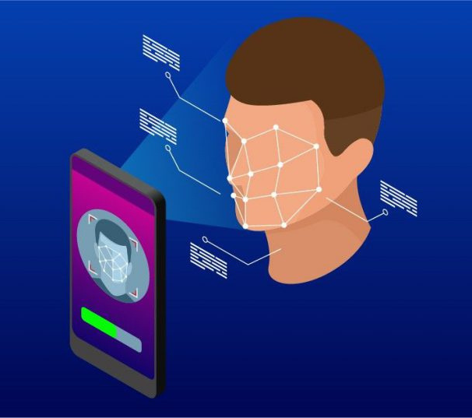
Alzheimer
Our Application's
FEATURES
Face Recognition
To remember the people who they know and interact with in their daily life by taking one single picture of a person's face

Slide 19
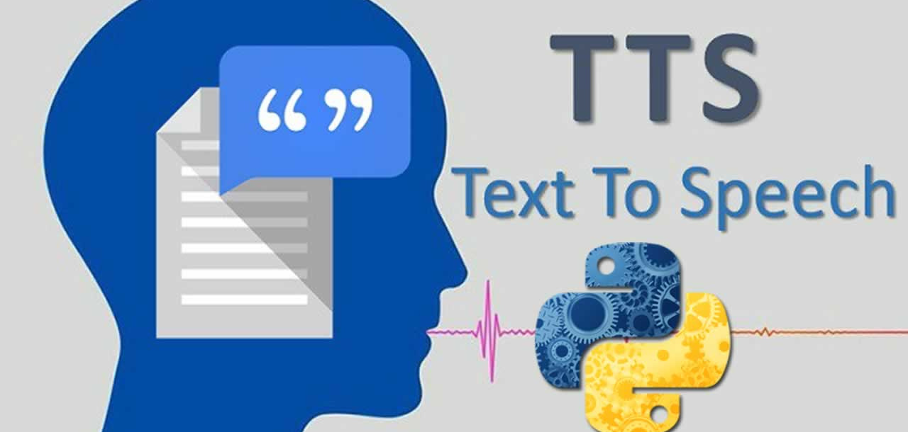
TTS

Slide 20
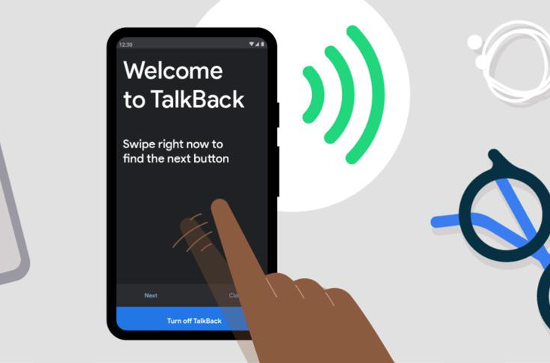

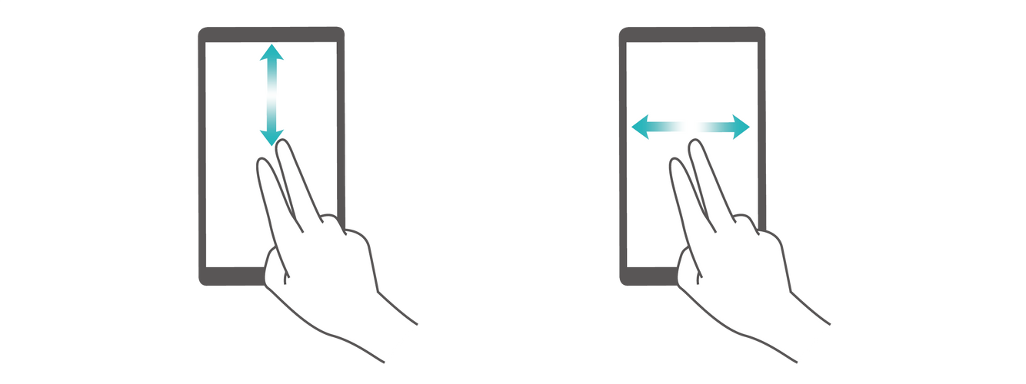
TalkBack
Google's free screen reader for Android devices. The software responds to familiar touch and swipe commands, allowing users to interact with websites and apps
TalkBack is. When activated, TalkBack announces where the user’s focus is located, enabling people to control their phones, tablets, and other Android devices without using visual cues. In certain apps, users can input other touch , voice commands and customized gestures.

Slide 21




Cloud Services
Google Cloud
Firebase
Microsoft Azure: Computer Vision
Heroku
For Integrate our python code to our App

Slide 22
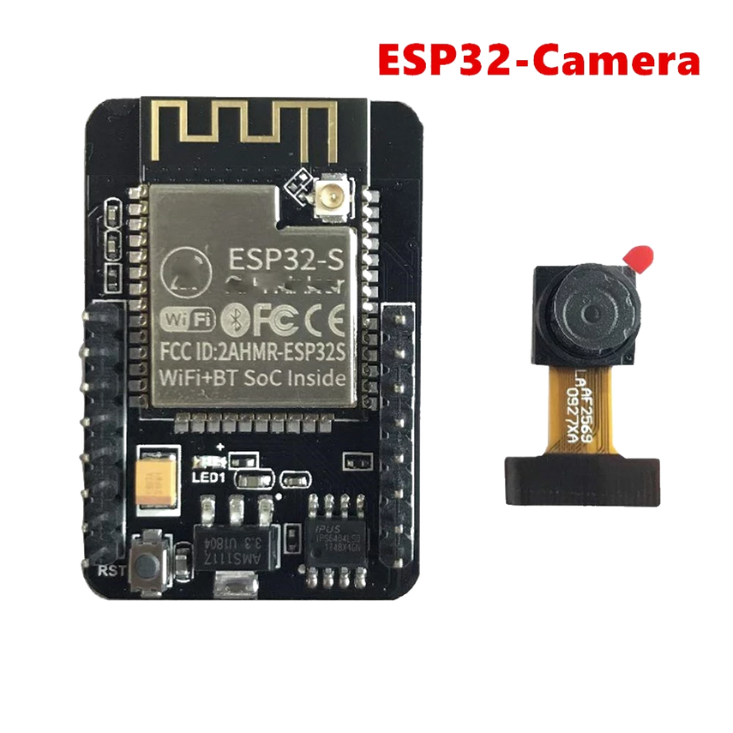
Hardware Approach
The ESP32-CAM is a small size, low power consumption camera module with the ESP32-S chip that costs approximately $10 based on ESP32 WIFI development board. It comes with an OV2640 camera, and it also features a microSD card slot that can be useful to store images taken with the camera or to store files to serve to clients.
Features:
• Onboard ESP32-S module, supports WiFi + Bluetooth
• OV2640 camera with built-in flash lamp
• Onboard MicroSD card slot, supports up to 4G TF card for data storage
• Supports WiFi video monitoring and WiFi image upload
• Supports multi sleep modes, deep sleep current as low as 6mA
• Control interface is accessible via pin-header, easy to be
integrated and embedded into user product
microSD card (importance in our product)
The photos taken by the chip will be saved to memory so that we can access the data for the Alzheimers people by checking the photos that are frequently taken by them
So that we can use this data to help in providing the doctors with needed data to help them in providing new treatments for Alzheimer

Slide 23
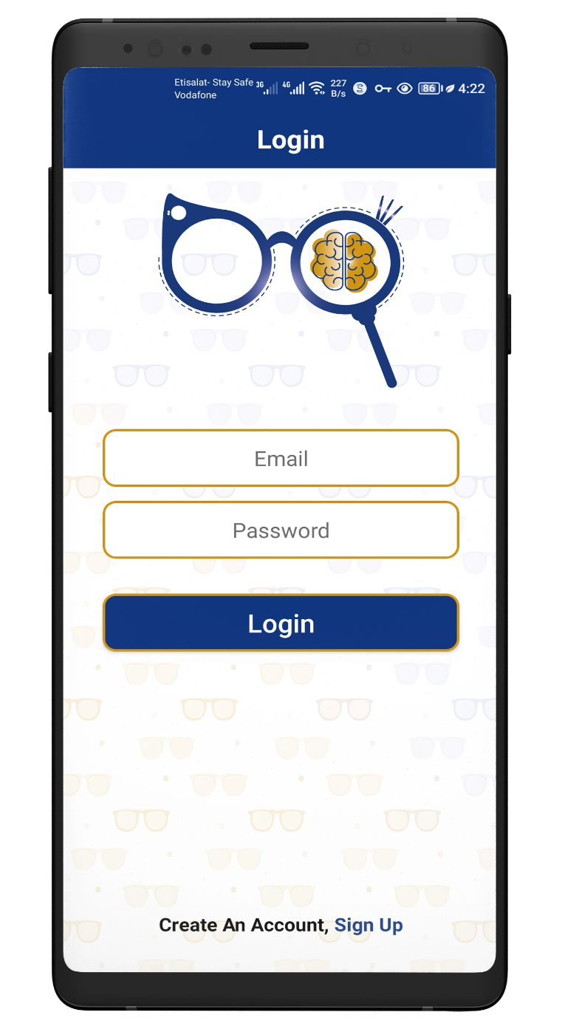
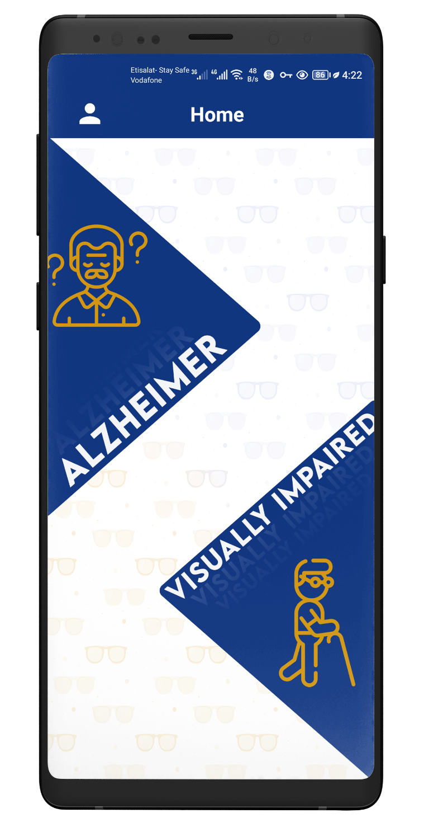
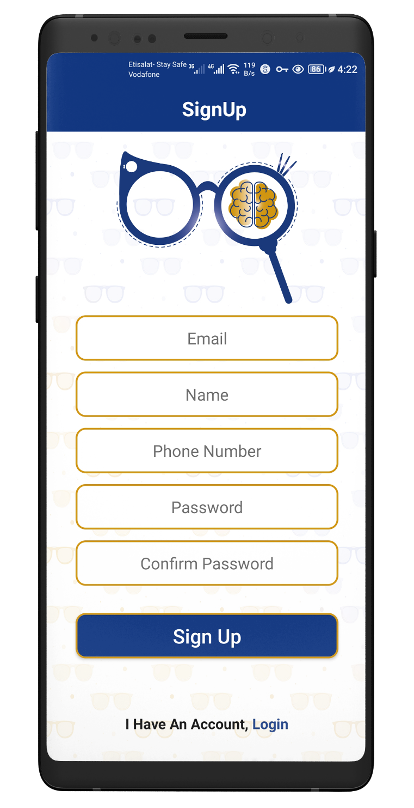
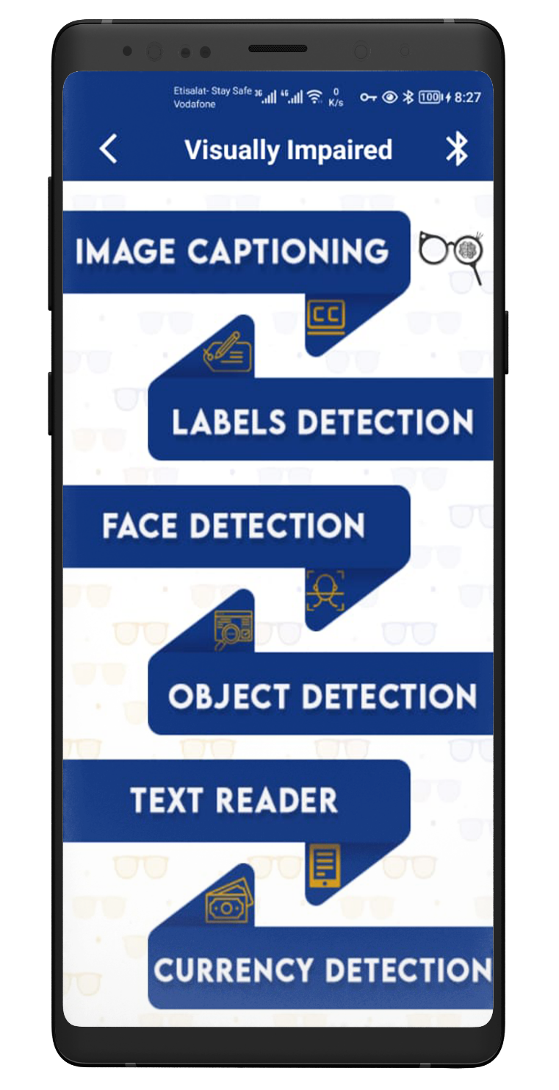
Visually
Impaired
IMPEMLENTAION
Home
Login Page
Visually Impaired Menu
Sign Up

Slide 24
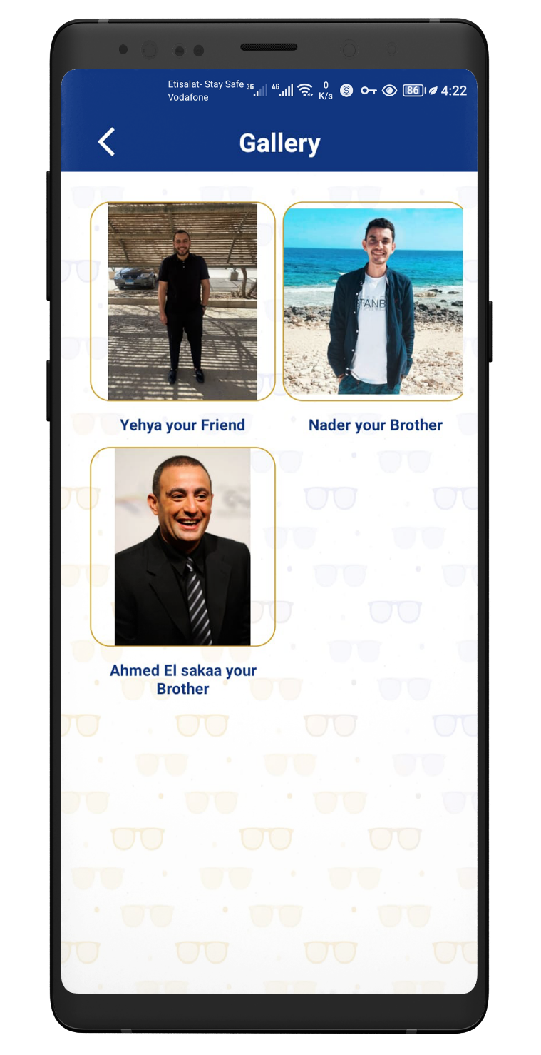
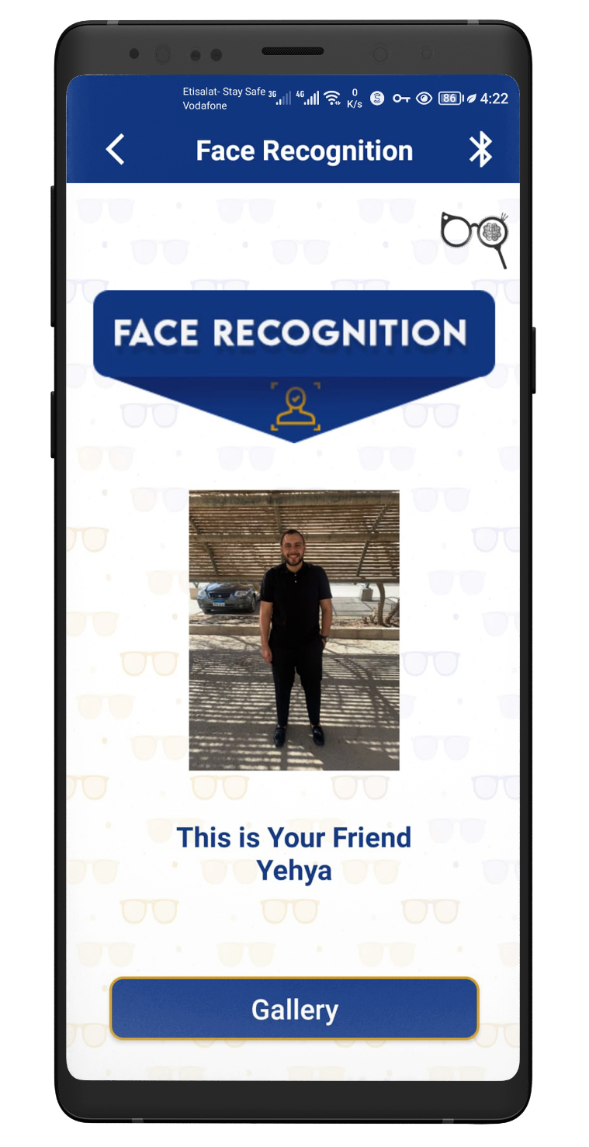
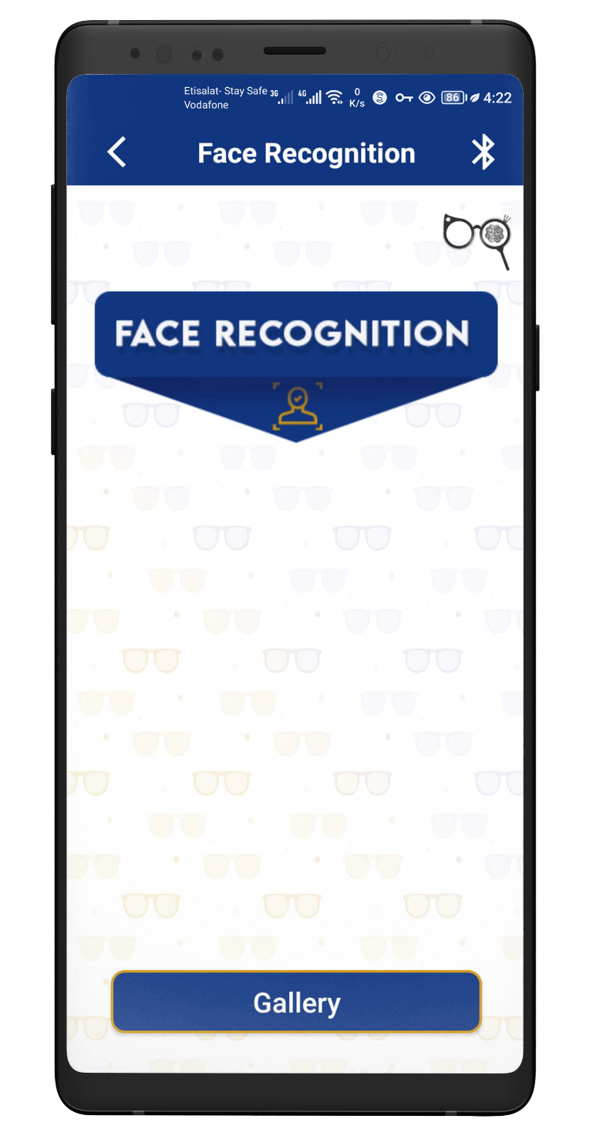
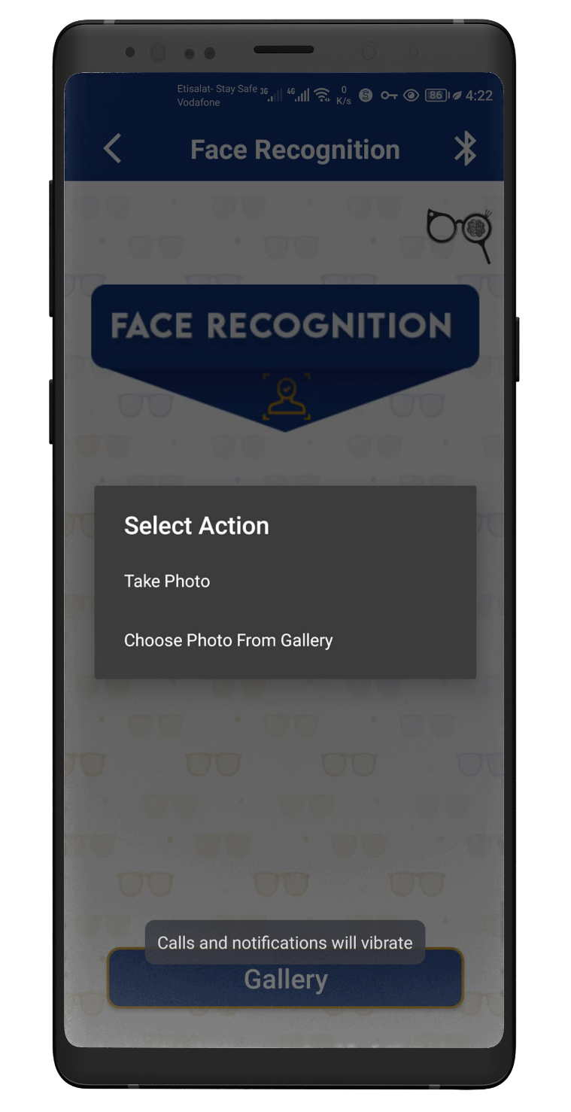
Face Recognition
IMPEMLENTAION

Slide 25




Tools
Google Colab
Arduino
Android Studio
PyCharm

Slide 26
How To Use
01
You can register and login as a user (First time login )
04
If you are visually impaired or blind:
first, activate Accessibility Mode
You can get the description of the scenes around you using the image captioning feature
You can know the famous landmarks around you by using the labels detection feature
You can have a brief description of the person next to you about his Gender, emotion, and expected age using the face detection feature
You can have a good image of the objects around you using the object detection feature
You can be reading any printed text anywhere ex: banners, receipts, bills, newspapers, … etc, using the text reader feature
And finally, you can classify the category of money do you have by using the currency recognition feature
02
You can capture the photo either by pressing the button on the camera or by using the uploading from gallery feature to choose the photo.
03
If you have Alzheimer's or you suffer from not being able to memorize the faces, you can use the face recognition feature from the Alzheimer’s mode.

Slide 27


Demo Video

Slide 28
Future Work
01
We can make some enhancements that improve our app’s reliability
05
Resize our pictures so that it won’t take more time to process on it from servers.
02
We can make the visually impaired user not to login, but Alzheimer user should login because he/she has a database of some pictures for the people he/she knows.
06
With the technological development we think that there will be some new cognitive services if this will serve our application and make it faster, we will add it.
03
07
In Currency recognition we just recognize that there’s currency and its class but we cannot count how much he/she have so we can improve it.
Solve some server issues because of pricing, buying a server with higher capabilities so that we can run more complex commands and models.
08
Trying to add more features to help Alzheimer patients like reminder them with the cure,notes and more informations about the people in their databases
04
Make the response faster than it was by just using another services.

Slide 29
Thank you!

